Slide 1
Week 4
Advanced Retrieval Queries

Slide 2
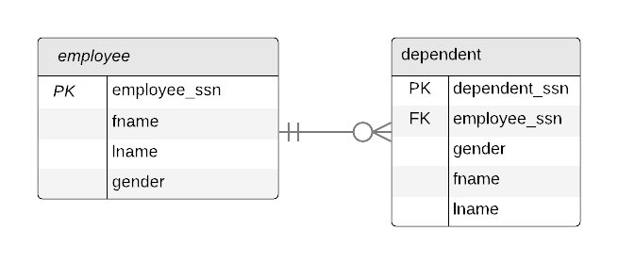
Subqueries
A query that is used within the WHERE, and FROM clauses in another query (a query within a query)
Useful for ‘filtering’ a table based upon query results from another table
Your book uses parenthesis within each of these clauses to write the sub-query
Can be difficult to understand in much larger queries
Correlated nested queries – a relationship exists between the two tables (query to the right)
--comment
SELECT E.fname, E.lname
FROM employee E
WHERE E.employee_ssn IN
(SELECT D.employee_ssn
FROM dependent D
WHERE D.gender = “M”)

Slide 3
Common Table Expressions (CTEs)
What Is the WITH Clause in SQL?
Link to CTE Reading
PostgreSQL: Documentation: 9.1: WITH Queries (Common Table Expressions)
AKA with() clause
All subqueries/temp tables are defined BEFORE the main query
All subqueries/temp tables are comma separated
Provides a neater way to write queries
with D as (SELECT employee_ssn
FROM dependent
WHERE gender = “M”)
SELECT e.fname
,e.lname
FROM employees E
WHERE E.employee_ssn IN D

Slide 4
UNIQUE, EXISTS, & renaming attributes
Can be used in the WHERE clause
EXISTS can be thought of as an INNER or ANTI JOIN (multiple value comparison)
However, EXISTS uses row-wise comparison – so it just checks if a row exists. INNER JOIN would join on DUPLICATE row-keys.
SQL EXISTS vs IN vs JOIN
SELECT fname, lname as last_name
FROM employee
WHERE EXISTS (SELECT *
FROM department
WHERE ssn=essn)

Slide 5
Joins, Aggregation, Case Statements, & Recursion

Slide 6
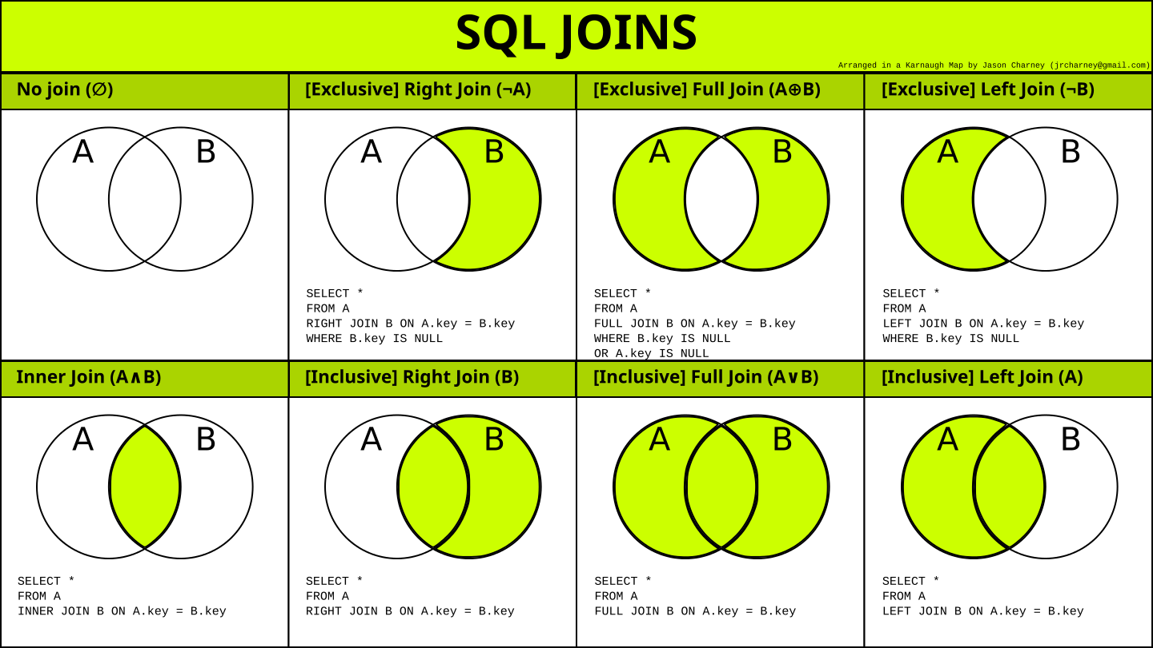
Notes:
EXCLUSIVE AKA ANTI JOIN
NATURAL JOIN – no ON condition, the query engine finds matching column names with the same data type and performs the join
PostgreSQL: Documentation: 15: 2.6. Joins Between Tables

Slide 7
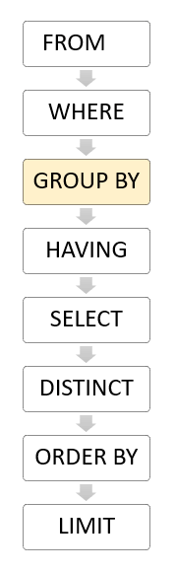
GROUP BY & HAVING
SELECT dno
,COUNT(*)
,AVG(salary)
FROM employee
WHERE dno != 1
GROUP BY dno
HAVING AVG(salary)>45000.00;
GROUP BY allows you to aggregate a table into summary statistics
GROUP BY attributes must be specified in the select statement
Aggregate functions can be applied to additional attributes
HAVING essentially returns only the groups that meet certain conditions
PostgreSQL: Documentation: 15: 9.21. Aggregate Functions

Slide 8
Case Statements
CASE WHEN is equivalent to many modern programming languages IF ELSE statements
Can be used within a SELECT statement
CASE WHEN <condition 1> THEN <value>
WHEN <condition 2> THEN <value>
ELSE <value>
UPDATE employee
SET salary =
CASE WHEN dno=5 THEN salary + 2000
WHEN dno=4 THEN salary + 1500
WHEN dno=1 THEN salary + 3000
ELSE salary + 0

Slide 9
Recursive Queries (CTE)
Helpful in many circumstances such as for querying hierarchical data like organizational structure, tracking lineage, etc.
Used in a with() CTE.
An example would be querying an employee table with manager and subordinates (see week 4 examples)
WITH RECURSIVE <alias> as (
<non-recursive query>
<statement that connects recursive query (union)>
<recursive query>
)
<statement that invokes recursion>
SELECT * FROM <alias>

Slide 10
Assertion, Triggers, & Views

Slide 11
Assertion
A data integrity constraint that can be used to ensure a specific condition cannot happen within a table
Example: employee salary cannot be greater than manager salary
CREATE ASSERTION salary_constraint
CHECK (NOT EXISTS (
SELECT *
FROM EMPLOYEE E, EMPLOYEE M, DEPARTMENT D
WHERE E.salary >M.salary
AND E.dno=D.dnumber
AND D.mgr_ssn=M.ssn

Slide 12
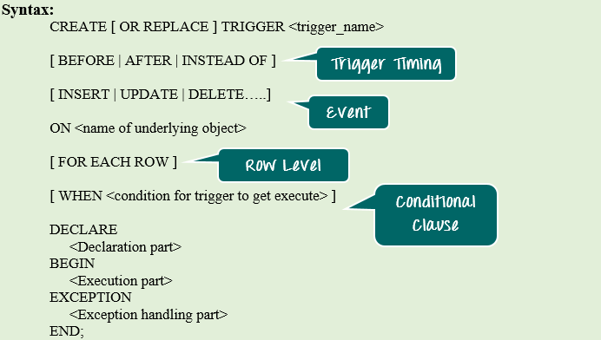
Triggers
Takes action when a specified event occurs in the DB
Event
The operations that are monitored for each condition
Condition
Used to monitor the DB
Action
Action that occurs when the condition is met, typically a SQL statement
PostgreSQL: Documentation: 15: CREATE TRIGGER

Slide 13
Views
“Views” of a query that are not materialized
When you access the view the query is executed.
Materialized view: These are created when the results of the query are stor ed in a DB
Views are most commonly used to present results of analytics queries to stakeholders
PostgreSQL: Documentation: 15: CREATE VIEW
PostgreSQL: Documentation: 15: 41.3. Materialized Views
CREATE VIEW AS <query>
CREATE MATERIALIZED VIEW AS <QUERY>

